Slide 1
Introduction to Front-End Frameworks and React

Slide 2
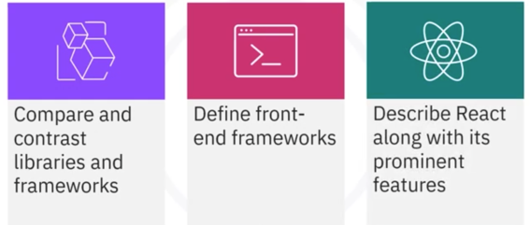
What you will learn

Slide 3

Introduction
React:
• Widely adopted for building
modern web applications

Slide 4

Introduction
React:
• Widely adopted for building
modern web applications
Libraries and frameworks:
• Essential tools in software
development
• Serve distinct purposes

Slide 5

Libraries
• Repository of pre-written code
segments
• Provide reusable functions and
routines
• Target specific tasks or
functionalities
• Offer flexibility for integration
• Examples: jQuery, Lodash, D3.js
and React

Slide 6

Frameworks
• A comprehensive software
development platform
• Provide foundation and structure
for application building
• Handle user requests
• Manage data flow
• Impose architecture
• Example: AngularJS, Ember JS,
Svelte, and Vue.js

Slide 7

Front-end frameworks
• User-facing
• Leverage HTML, CSS, and
JavaScript
• Create dynamic and
interactive user interfaces

Slide 8
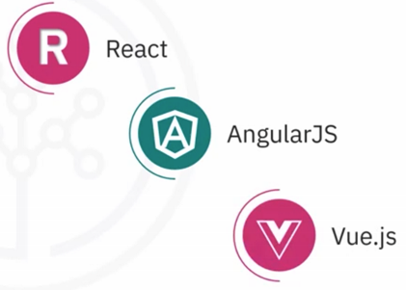
Front-end frameworks
• User-facing
• Leverage HTML, CSS, and
JavaScript
• Create dynamic and
interactive user interfaces

Slide 9
React
Facilitates the creation
of interactive user
interfaces
An open-source
JavaScript library

Slide 10
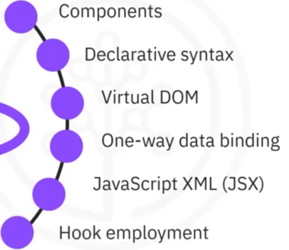

Features of React

Slide 11

Component-based architecture
• Emphasizes reusable UI elements
• Composing independent
components

Slide 12
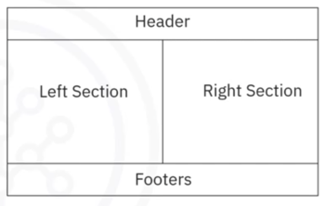
Component-based architecture
• Emphasizes reusable UI elements
• Composing independent
components
• Encapsulates UI functionality in
individual files
• Easy to use without duplication

Slide 13




Declarative syntax

Slide 14

Virtual DOM
• Generates virtual DOM copies
• Compares to real DOM
• Updates essential segments
• Optimizes performance
• Minimizes DOM modifications

Slide 15
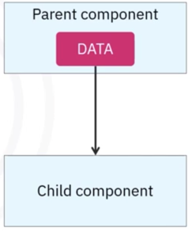
One-way data binding
• Data flows unidirectionally
• Simplifies data management
• Reduces bugs

Slide 16
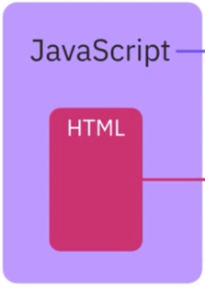
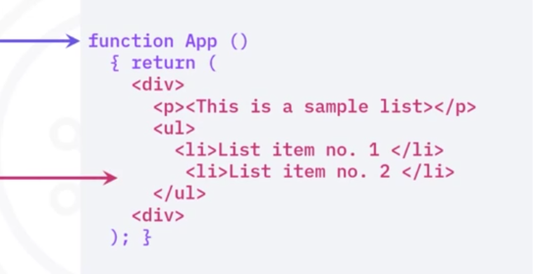
JavaScript XML

Slide 17

Hook employment
• Handle states
• No need for class components
• Simplify component logic
• Promote code reuse
• Easily manage stateful behavior

Slide 18
Recap
In this video, you learned that:
• Libraries offer reusable code components, while frameworks
provide a comprehensive structure for building applications
• Front-end frameworks focus on building the user-facing side of
web applications
• React is an open-source JavaScript library developed by
Facebook that facilitates the creation of dynamic and interactive
user interfaces for web applications
• React features include component-based architecture,
declarative syntax, virtual DOM optimization, one-way data
binding, JSX integration, and React Hooks employment

